Slide 1
Voluntary contribution to EPF
As of now, as per the statutory requirement under Employees provident Fund and Misc. Provisions Act, 1952 we are deducting the 12% from your basic Salary & Company contributes 12% to your EPF Corpus subject to maximum Basic Pay of Rs.15000/-.
But over and above 12% percent Contribution, you can choose to direct more of your Salary towards EPF. This additional contribution qualifies as voluntary provident fund.

Slide 2
Benefits:
1.Employee Contribution to EPF qualify for deduction under Section 80C of Income Tax Act.
2.Employer Contribution to EPF is fully exempt from Tax.
3.Interest accumulated during the investment period will also tax free as will the maturity amount.
4. Employee will have guaranteed corpus for retirement.
5.The rate of interest usually declared by the EPFO is higher than that of several other debt instruments, besides being secure.

Slide 3
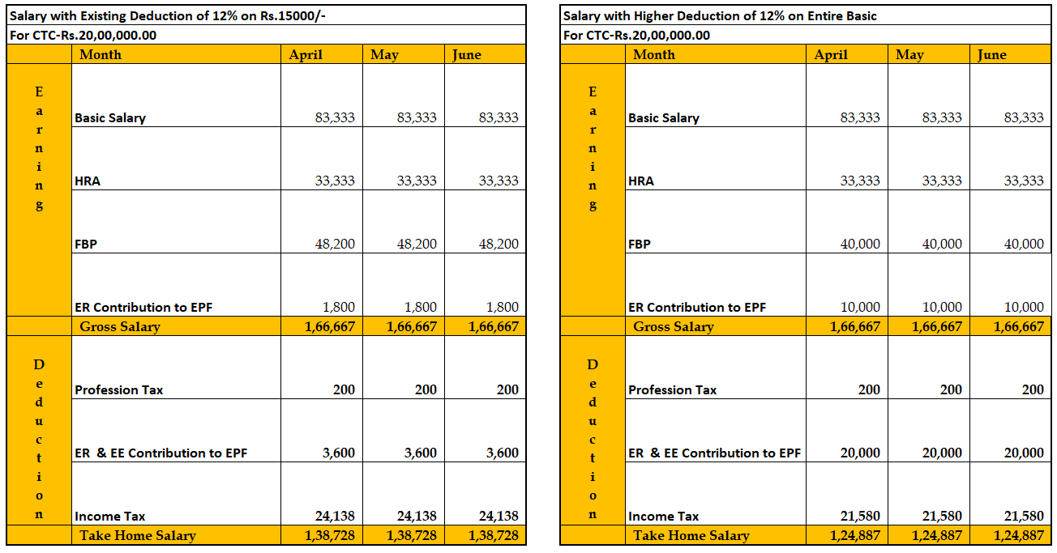
Monthly Salary.

Slide 4
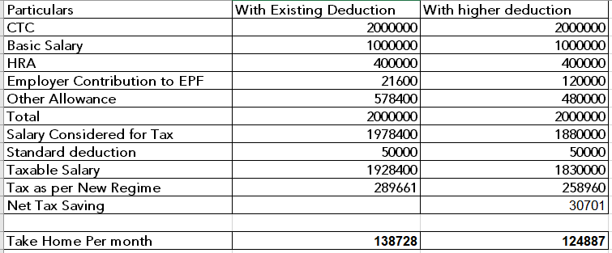
Illustration for Tax calculation.

Slide 5
Conclusion:
If your Monthly Cashflow permit additional Investment and you wish to invest more to ensure secure retirement years, you can go with higher deduction for EPF by giving joint declaration to Accounts.

